Slide 1
Introduction to Data Analysis with R and Python Statistical Tools for Data Mining and Analytics
Session 1
David Ryan
February 12, 2015

Slide 2
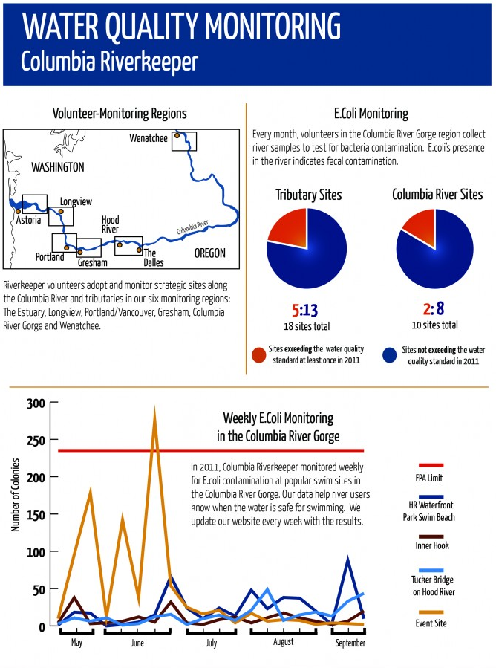
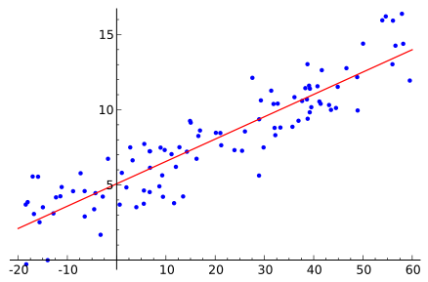
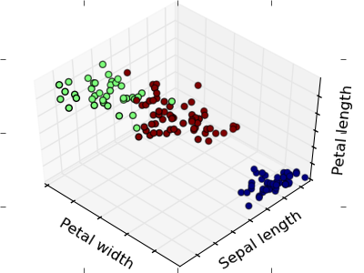
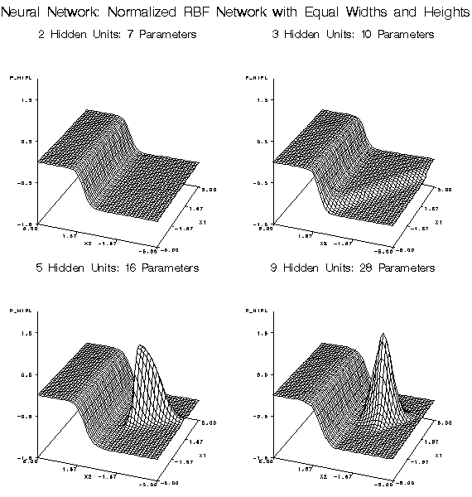
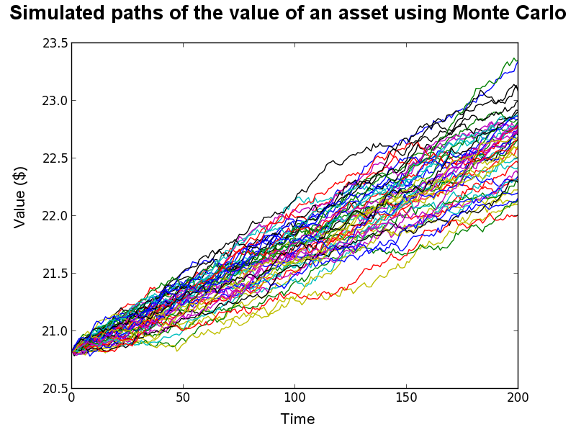
Data Analytics
DATA DESCRIPTION
Statistical Analysis
Reporting
 | Sepal Length | Sepal Width | Petal Length | Petal Width
Mean | 5.84 | 3.05 | 3.76 | 1.20
Standard Error | 0.07 | 0.04 | 0.14 | 0.06
Median | 5.80 | 3.00 | 4.35 | 1.30
Mode | 5.00 | 3.00 | 1.50 | 0.20
Standard Deviation | 0.83 | 0.43 | 1.76 | 0.76
Sample Variance | 0.69 | 0.19 | 3.11 | 0.58
Kurtosis | -0.55 | 0.29 | -1.40 | -1.34
Skewness | 0.31 | 0.33 | -0.27 | -0.10
Range | 3.60 | 2.40 | 5.90 | 2.40
Minimum | 4.30 | 2.00 | 1.00 | 0.10
Maximum | 7.90 | 4.40 | 6.90 | 2.50
Sum | 876.50 | 458.10 | 563.80 | 179.80
Count | 150.00 | 150.00 | 150.00 | 150.00
Predictive Modeling
Clustering
Simulation & Optimization
DATA MODELING
Notes:
Images:
http://www.smhollingsworth.com/info/?p=430
http://scikit-learn.org/0.11/tutorial/statistical_inference/unsupervised_learning.html
http://en.wikipedia.org/wiki/Regression_analysis
http://support.sas.com/documentation/cdl/en/emxndg/64759/HTML/default/viewer.htm#p0x88tgo39zcyfn1qtikby80tn3a.htm
http://continuum.io/blog/monte-carlo-pricer (valuable resource for Monte Carlo simulation!!)

Slide 3
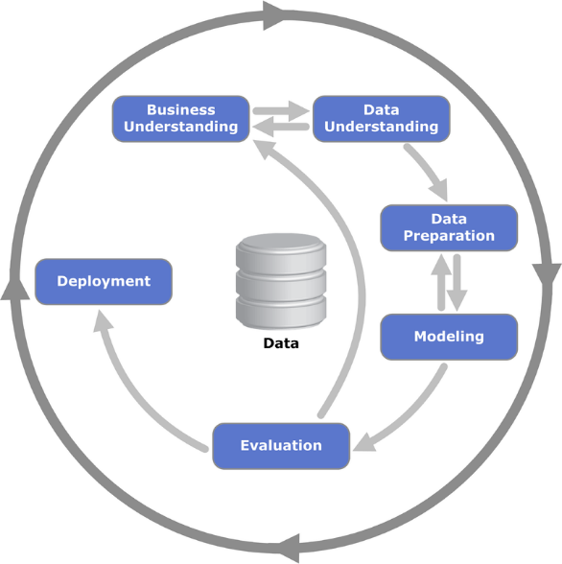
CRISP-DM
Goal Definition
Test and learn
C ross
I ndustry
S tandard
P rocess for
D ata
M ining
operationalize
Knowledge Application
Notes:
Images:
http://en.wikipedia.org/wiki/Cross_Industry_Standard_Process_for_Data_Mining

Slide 5
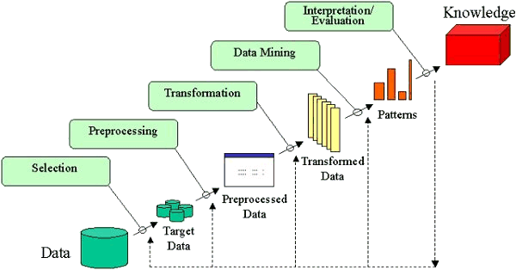
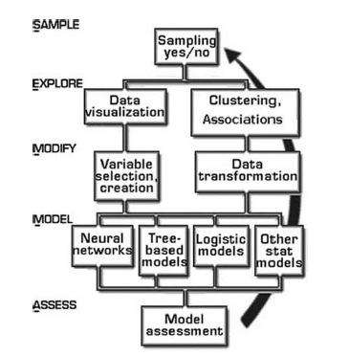
KDD
SEMMA
Notes:
KDD = Knowledge Discovery in Databases
SEMMA = Sample, Explore, Modify, Model and Assess
Images:
http://www.dataprix.net/en/blogs/respinosamilla/theory-data-mining
http://decisionstats.com/tag/knowledge-discovery/

Slide 6

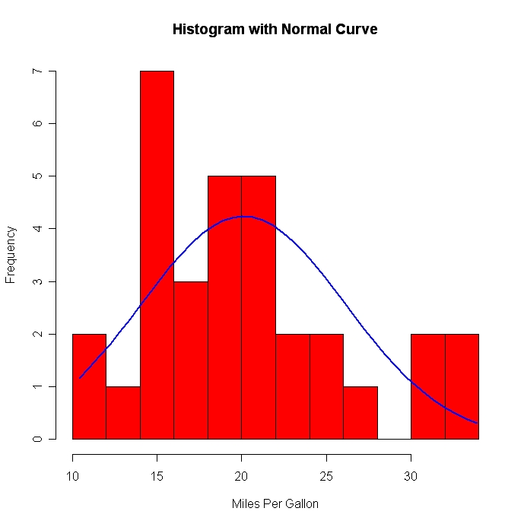

CRISP-DM
Business Understanding
Data Understanding
 | Sepal Length | Sepal Width | Petal Length | Petal Width
Mean | 5.84 | 3.05 | 3.76 | 1.20
Standard Error | 0.07 | 0.04 | 0.14 | 0.06
Median | 5.80 | 3.00 | 4.35 | 1.30
Mode | 5.00 | 3.00 | 1.50 | 0.20
Standard Deviation | 0.83 | 0.43 | 1.76 | 0.76
Sample Variance | 0.69 | 0.19 | 3.11 | 0.58
Kurtosis | -0.55 | 0.29 | -1.40 | -1.34
Skewness | 0.31 | 0.33 | -0.27 | -0.10
Range | 3.60 | 2.40 | 5.90 | 2.40
Minimum | 4.30 | 2.00 | 1.00 | 0.10
Maximum | 7.90 | 4.40 | 6.90 | 2.50
Sum | 876.50 | 458.10 | 563.80 | 179.80
Count | 150.00 | 150.00 | 150.00 | 150.00
Notes:
Images:
http://www.ssonetwork.com/transformation-innovation/columns/understanding-business-commercial-performance/
http://www.flaticon.com/free-icon/bald-head-with-lightbulb-with-exclamation-sign-inside_33183

Slide 7
CRISP-DM: Data Understanding and Preparation
Name | Age of Retirement | Annual Social Security Benefit
John C. | 70 | $32,000
Bill R. | 68 | $24,000
Cliff J. | 56 | $18,000
Ann S. | 62 | $16,720
Jill Q. | 66 | $19,012
Name | Age | State of Residence | Living Relatives | Age of Retirement | Serious Medical Conditions | Gender | Annual Social Security Benefit
John C. | 89 | NY | Y | 70 | Diabetes | Male | $32,000
Bill R. | 78 | Texas | NO | 68 | None | M | $24,000
Cliff J. | 76 | FL | Y | 56 | COPD | M | 18,000
Ann S. | 72 | 08 | Yes | 62 | Alzheimer's | F | $16720
Jill Q. | 71 | RI | N | 66 |  | Fm | $19,012.25
Name | Age | State of Residence | Living Relatives | Age of Retirement | Serious Medical Conditions | Gender | Annual Social Security Benefit
John C. | 89 | NY | Y | 70 | Diabetes | Male | $32,000
Bill R. | 78 | Texas | NO | 68 | None | M | $24,000
Cliff J. | 76 | FL | Y | 56 | COPD | M | 18,000
Ann S. | 72 | 08 | Yes | 62 | Alzheimer's | F | $16720
Jill Q. | 71 | RI | N | 66 | ? | F | $19,012.25
Name | Age | State of Residence | Living Relatives | Age of Retirement | Serious Medical Conditions | Gender | Annual Social Security Benefit
John C. | 89 | NY | Y | 70 | Diabetes | Male | $32,000
Bill R. | 78 | TX | NO | 68 | None | M | $24,000
Cliff J. | 76 | FL | Y | 56 | COPD | M | 18,000
Ann S. | 72 | 08 | Yes | 62 | Alzheimer's | F | $16720
Jill Q. | 71 | RI | N | 66 | ? | F | $19,012.25
Name | Age | State of Residence | Living Relatives | Age of Retirement | Serious Medical Conditions | Gender | Annual Social Security Benefit
John C. | 89 | NY | Y | 70 | Diabetes | Male | $32,000
Bill R. | 78 | TX | NO | 68 | None | M | $24,000
Cliff J. | 76 | FL | Y | 56 | COPD | M | 18,000
Ann S. | 72 | FL | Yes | 62 | Alzheimer's | F | $16720
Jill Q. | 71 | RI | N | 66 | ? | F | $19,012.25
Name | Age | State of Residence | Living Relatives | Age of Retirement | Serious Medical Conditions | Gender | Annual Social Security Benefit
John C. | 89 | NY | Y | 70 | Diabetes | Male | $32,000
Bill R. | 78 | TX | N | 68 | None | M | $24,000
Cliff J. | 76 | FL | Y | 56 | COPD | M | 18,000
Ann S. | 72 | FL | Yes | 62 | Alzheimer's | F | $16720
Jill Q. | 71 | RI | N | 66 | ? | F | $19,012.25
Name | Age | State of Residence | Living Relatives | Age of Retirement | Serious Medical Conditions | Gender | Annual Social Security Benefit
John C. | 89 | NY | Y | 70 | Diabetes | Male | $32,000
Bill R. | 78 | TX | N | 68 | None | M | $24,000
Cliff J. | 76 | FL | Y | 56 | COPD | M | 18,000
Ann S. | 72 | FL | Y | 62 | Alzheimer's | F | $16720
Jill Q. | 71 | RI | N | 66 | ? | F | $19,012.25
Name | Age | State of Residence | Living Relatives | Age of Retirement | Serious Medical Conditions | Gender | Annual Social Security Benefit
John C. | 89 | NY | Y | 70 | Diabetes | Male | $32,000
Bill R. | 78 | TX | N | 68 | None | M | $24,000
Cliff J. | 76 | FL | Y | 56 | COPD | M | 18,000
Ann S. | 72 | FL | Y | 62 | Alzheimer's | F | $16720
Jill Q. | 71 | RI | N | 66 | None | F | $19,012.25
Name | Age | State of Residence | Living Relatives | Age of Retirement | Serious Medical Conditions | Gender | Annual Social Security Benefit
John C. | 89 | NY | Y | 70 | Diabetes | M | $32,000
Bill R. | 78 | TX | N | 68 | None | M | $24,000
Cliff J. | 76 | FL | Y | 56 | COPD | M | 18,000
Ann S. | 72 | FL | Y | 62 | Alzheimer's | F | $16720
Jill Q. | 71 | RI | N | 66 | None | F | $19,012.25
Name | Age | State of Residence | Living Relatives | Age of Retirement | Serious Medical Conditions | Gender | Annual Social Security Benefit
John C. | 89 | NY | Y | 70 | Diabetes | M | $32,000
Bill R. | 78 | TX | N | 68 | None | M | $24,000
Cliff J. | 76 | FL | Y | 56 | COPD | M | $18,000
Ann S. | 72 | FL | Y | 62 | Alzheimer's | F | $16720
Jill Q. | 71 | RI | N | 66 | None | F | $19,012.25
Name | Age | State of Residence | Living Relatives | Age of Retirement | Serious Medical Conditions | Gender | Annual Social Security Benefit
John C. | 89 | NY | Y | 70 | Diabetes | M | $32,000
Bill R. | 78 | TX | N | 68 | None | M | $24,000
Cliff J. | 76 | FL | Y | 56 | COPD | M | $18,000
Ann S. | 72 | FL | Y | 62 | Alzheimer's | F | $16,720
Jill Q. | 71 | RI | N | 66 | None | F | $19,012.25
Name | Age | State of Residence | Living Relatives | Age of Retirement | Serious Medical Conditions | Gender | Annual Social Security Benefit
John C. | 89 | NY | Y | 70 | Diabetes | M | $32,000
Bill R. | 78 | TX | N | 68 | None | M | $24,000
Cliff J. | 76 | FL | Y | 56 | COPD | M | $18,000
Ann S. | 72 | FL | Y | 62 | Alzheimer's | F | $16,720
Jill Q. | 71 | RI | N | 66 | None | F | $19,012

Slide 8
Data Analysis
Modeling
Name | Age | State of Residence | Living Relatives | Age of Retirement | Serious Medical Conditions | Gender | Annual Social Security Benefit
John C. | 89 | NY | Y | 70 | Diabetes | M | $32,000
Bill R. | 78 | TX | N | 68 | None | M | $24,000
Cliff J. | 76 | FL | Y | 56 | COPD | M | $18,000
Ann S. | 72 | FL | Y | 62 | Alzheimer's | F | $16,720
Jill Q. | 71 | RI | N | 66 | None | F | $19,012
Name | Age | State of Residence | Age of Retirement | Serious Medical Conditions | Annual Social Security Benefit
John C. | 89 | NY | 70 | Diabetes | $32,000
Bill R. | 78 | TX | 68 | None | $24,000
Cliff J. | 76 | FL | 56 | COPD | $18,000
Ann S. | 72 | FL | 62 | Alzheimer's | $16,720
Jill Q. | 71 | RI | 66 | None | $19,012
Regression
Time Series
Decision Tree

Slide 9










Statistical Software

Slide 10
What is R?
FREE statistics and graphics environment!
Interactive
High-level programming language
Allows for rapid development!
Notes:
Free statistics and graphics environment that blurs the distinction between users and programmers
A system for interactive data analysis – queries, summaries, table views, graphical displays, outputs
High level programming language – scripts and functions that can be repeated
Good system for rapid development of statistical applications (time is money!)

Slide 11
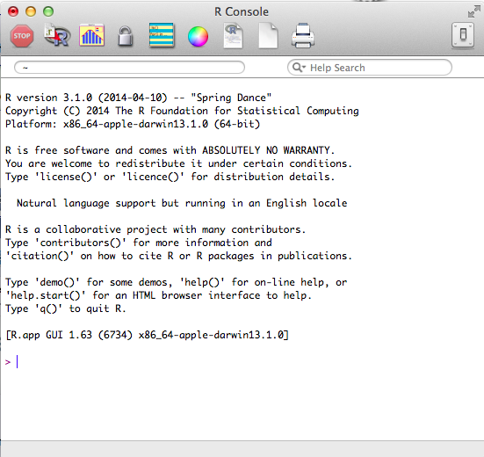
Basics of R
Downloadable:
http://www.r-project.org
Packages and libraries available
Shared resources
Notes:
R is freeware! So it can be downloaded from r-project.org for whatever operating system you have!
On this same website, you can also find an abundance of valuable resources
Tutorials and manuals
Downloadable packages that make statistical analyses and operations easy and available with simple, one-line commands
Shared resources (also available from other websites for the community of R users)

Slide 12
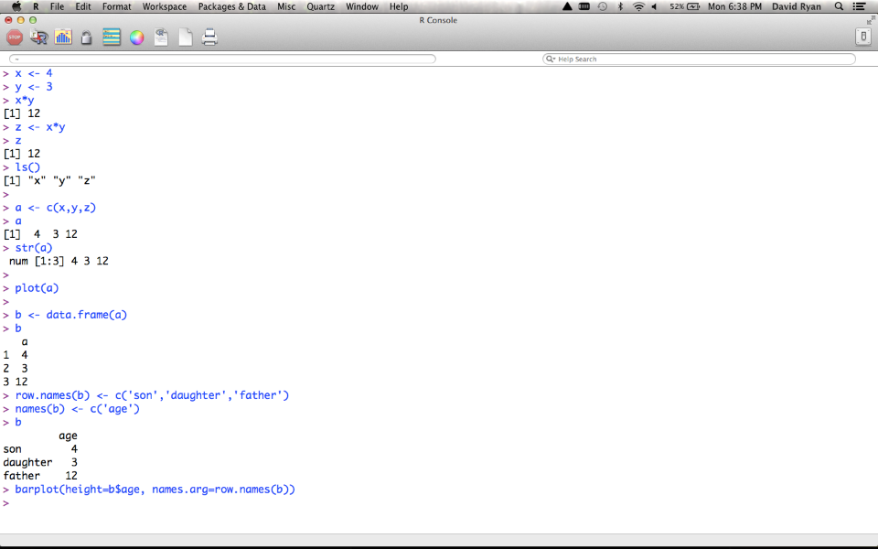
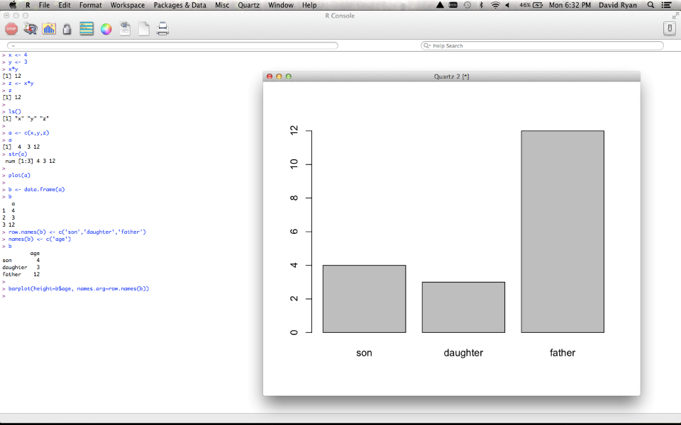
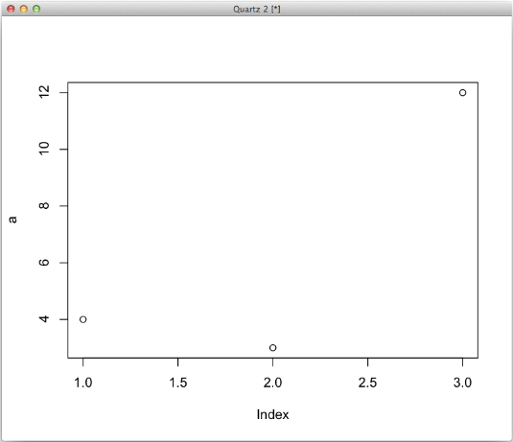
Basics of R
Notes:
Basic operations in R look much like those on your calculator!
- Assign values to variables & perform operations
Create lists (variable vectors)
Can create graphs from variables
Can modify tables for customized properties

Slide 13

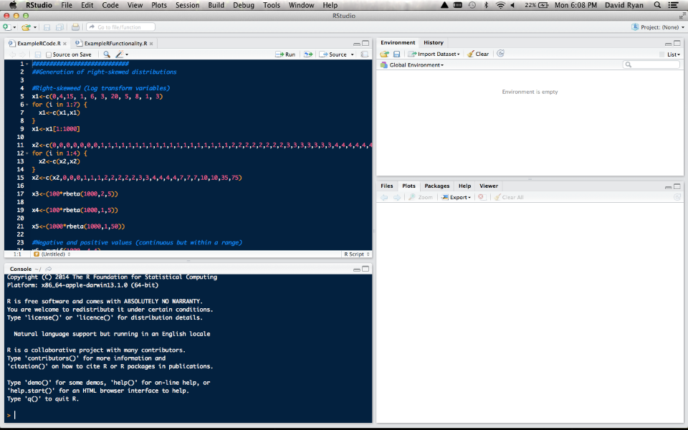
Notes:
This is all great, but with all of that typing, it can be easy to forget what you are working with
What if we could keep track of all of our variables, see code we were working on as well as executing and view graphs all in the same window?
Luckily there is Rstudio!
Can download at rstudio.com
Has a Console for executing live code
A window for scripting (saved code)
An environment to track variables and data
History to see lists of previous commands in case you clear your workspace
Multitab viewer for plots, packages, help, etc.

Slide 14
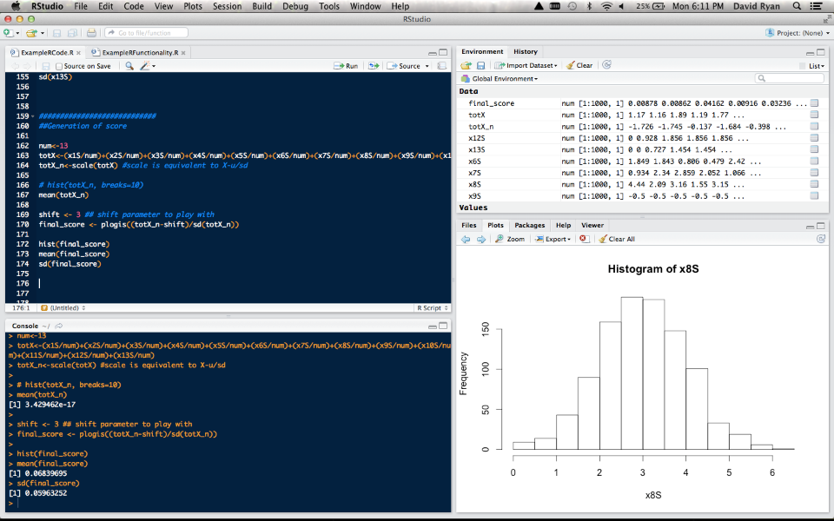
Notes:
As you can see here, Rstudio does much the same things as R, except it is all in one place!

Slide 15
What can R do?
Read data
Data summaries
Graphics
Scripts
Data summaries
Functions / Packages
Models
Notes:
Basic functionality
Reading data
Simple data summaries
Graphics
Scripts
Stratified data summaries
Functions and Packages
Models

Slide 16
Reading Data with R
Text files, data sets, web pages, databases
> salary2 <- read.table('Documents/RCourse/salary.txt', header=T)
> airquality2 <- read.table('Documents/RCourse/airquality.csv', header=T, sep=',')
Notes:
Working with tables and databases
All commands in R are treated equally – they all are functions and return values
These assign data to a variable
Functions have optional arguments that can be included or excluded based on data type (i.e. sep)
Storing data sets in variables allows more than one dataset to be available at any given time
We can get into lists of these common functions later, but it is often best to learn by playing around in R!

Slide 17
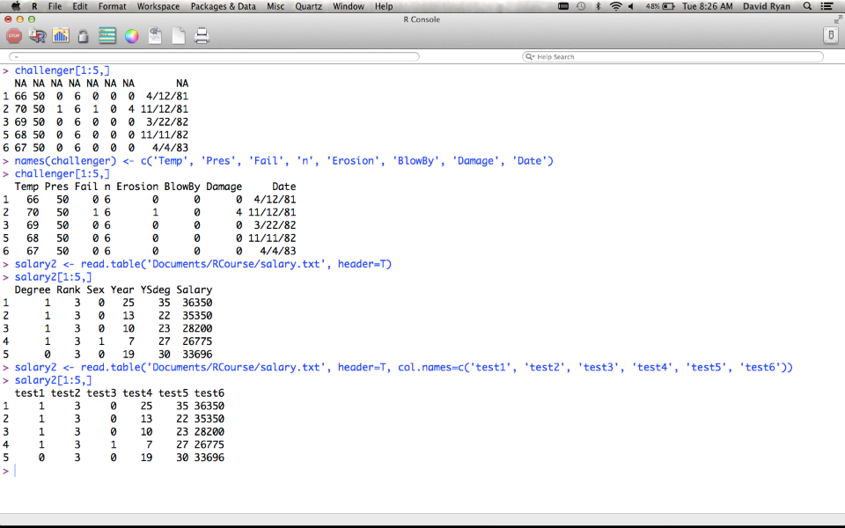
Reading Data with R
Notes:
Working with tables and databases
Here we see several examples of data tables (this time in R itself to simplify view)
Challenger is a data set included with R (many like this to play with)
Can access designated rows
Rename columns
Other function to note: Is.na()

Slide 18
Reading Data with R
psa <- read.table("psa.txt", col.names=c("ptid","nadirpsa",
"pretxpsa", "ps","bss","grade","age",
"obstime","inrem"))
psa <- read.table("psa.txt")
names(psa) <- c("ptid","nadirpsa","pretxpsa", "ps",
"bss","grade","age","obstime","inrem"))
fl2000<-read.table("http://faculty.washington.edu/tlumley/
data/FLvote.dat", header=TRUE)
Notes:
Working with tables and databases
Here we can just see different ways of reading data
- you can consolidate the processes we just went through by putting arguments into initial function!
- NOTE: you can also read data directly from the web
Resource (for next few slides):
http://faculty.washington.edu/tlumley/Rcourse/R-fundamentals.pdf

Slide 19
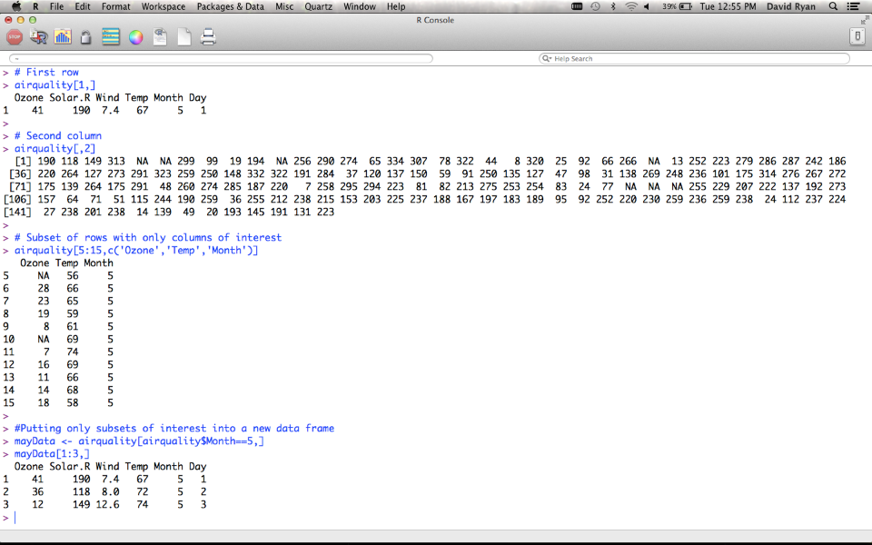
Data Subsets
Notes:
Here we see examples of accessing dataframe elements
Whole rows
Whole columns
Specific subset
Reassigning subset

Slide 20
Data Subsets
## First element
antibiotics$temp[1]
## All but first element
antibiotics$temp[-1]
## Elements 5 through 10
antibiotics$temp[5:10]
## Elements 5 and 7
antibiotics$temp[c(5,7)]
## People who received antibiotics antibiotics$temp[antibiotics$
antib==1 ]
## or
with(antibiotics, temp[antib==1])
## First row
antibiotics[1,]
## Second column
antibiotics[,2]
## Some rows and columns
antibiotics[3:7, 2:4]
## Columns by name
antibiotics[, c("id","temp","wbc")]
## People who received antibiotics
antibiotics[antibiotics$antib==1,]
## Put subset into a new data frame
yes <- antibiotics[antibiotics$antib==1,]
Notes:
Here are examples of calling items from a database
When you specify a variable, you only need one call number (because you have turned this into a vector)
When no variable is specified, you are still working with the whole dataframe, so you need to specify record (row) and column (variable)

Slide 21
Simple Data Summaries
mean(antibiotics$temp)
median(antibiotics$temp)
var(antibiotics$temp)
sd(antibiotics$temp)
mean(antibiotics$temp[antibiotics$antib==1])
with(antibiotics, mean(temp[sex==2]))
toohot <- with(antibiotics, temp>99)
mean(toohot)
Notes:
Working with tables and database: Last 3
Mean of temperature when there was an antibiotic used
Mean of temperature when sex=2 for the antibiotic data set
Mean of instances of cases within antibiotics when temperature>99 (percentage of the time this occurs)

Slide 22
Simple Data Summaries
> table(salary$rank,salary$field)
Arts Other Prof
Assist 668 2626 754
Assoc 1229 4229 1071
Full 942 6285 1984
> antibiotics$antib<-factor(antibiotics$antib,
labels=c("Yes","No"))
> antibiotics$agegp<-cut(antibiotics$antib, c(0,18,65,100))
> table(antibiotics$agegp)
(0,18] (18,65] (65,100]
2 19 4
Notes:
Working with tables and databases
- Factors represent categorical variables. You can’t do mathematical operations on them (except for ==)

Slide 23
Graphics
## scatterplot
plot(salary~year, data=salary)
## boxplot
plot(salary$rank, salary$salary)
## stacked barplot
plot(salary$field, salary$rank)
Notes:
plot() command can be written plot(salary~rank, data=salary)
Formula system
Or in plot(x,y)
Demo with demo(graphics)

Slide 24
Scripts & Functions
Notes:
Working with tables and databases – lots available!! Learn through Googling and through examples (more in subsequent lessons)

Slide 25
Need more help?
help(fn)
help.search("topic")
apropos("tab")
Search function on http://www.r-project.org

